Slide 1


Team Name : In_queue
Team Details : Dipali Vala
Vatsala Shah
Nilam Solanki

Slide 2

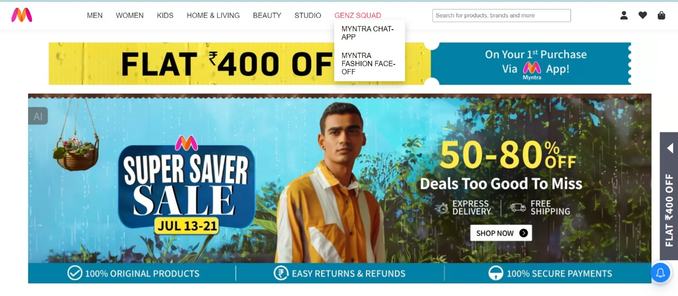
Join Myntra Chat-App: Connect with your fashion crew, share outfits, follow stylish users, discuss the new trends and get recommendations .Also video call your squad!
Join the Myntra Fashion Face-off... drop your designs, win polls, and get your creation approved and free if you're the top designer each month!

Slide 3

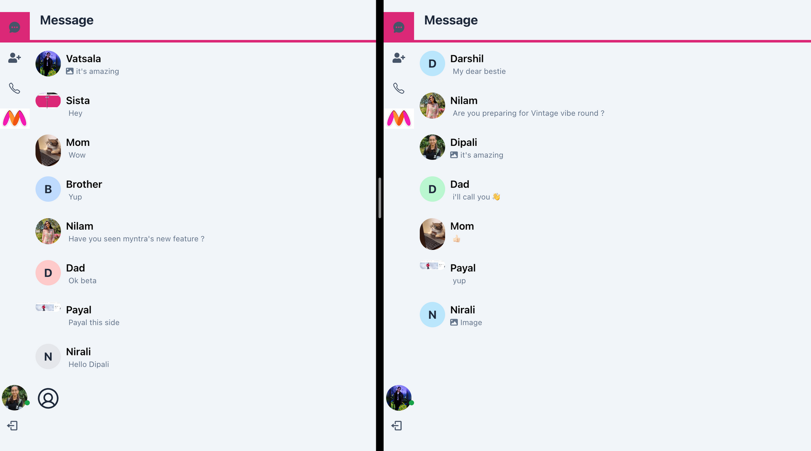
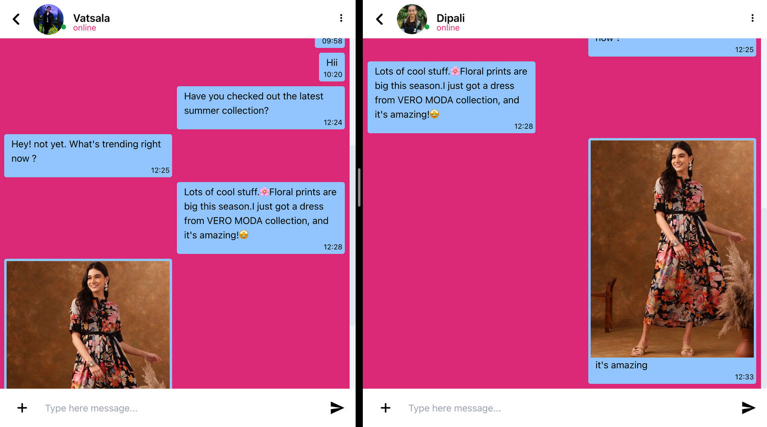
Myntra Chat-App
Users can connect with their fashion crew, flaunt outfits, follow trendsetters, discuss the latest styles, get personalized recommendations, and video call their squad!

Slide 4
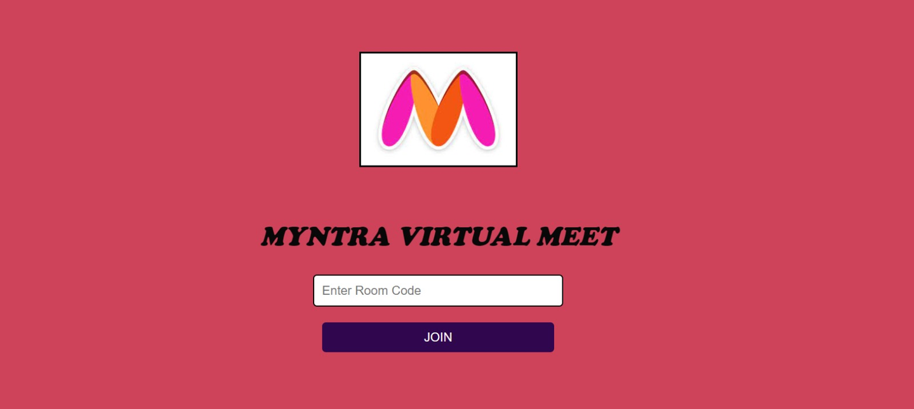
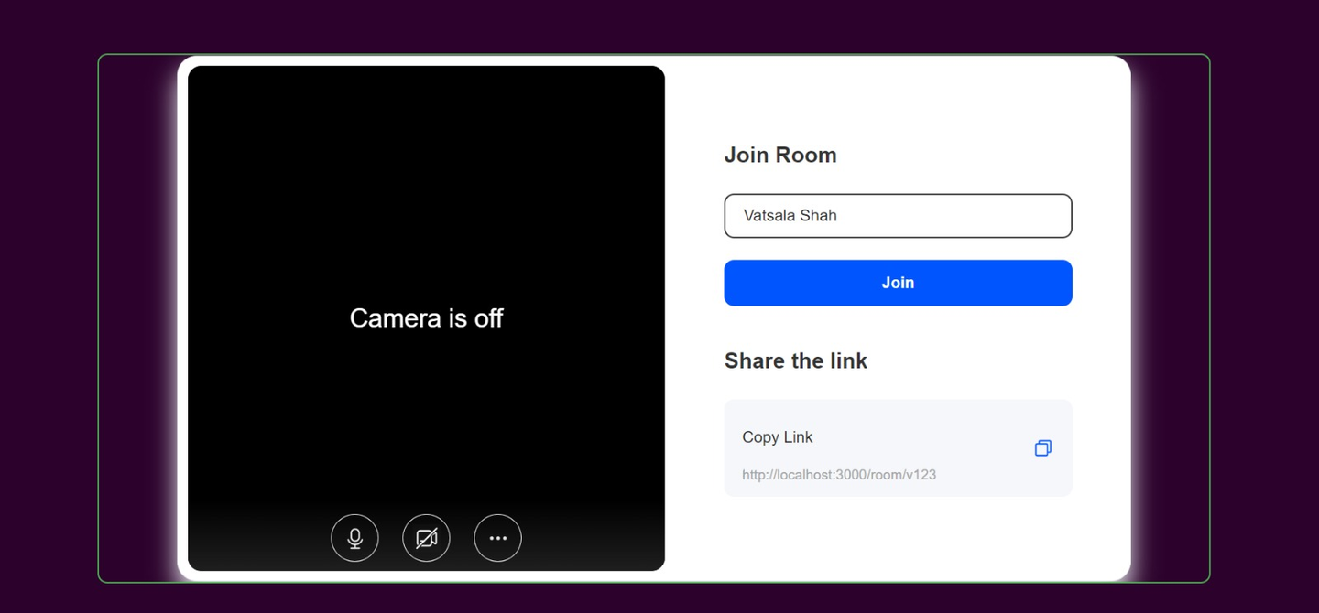
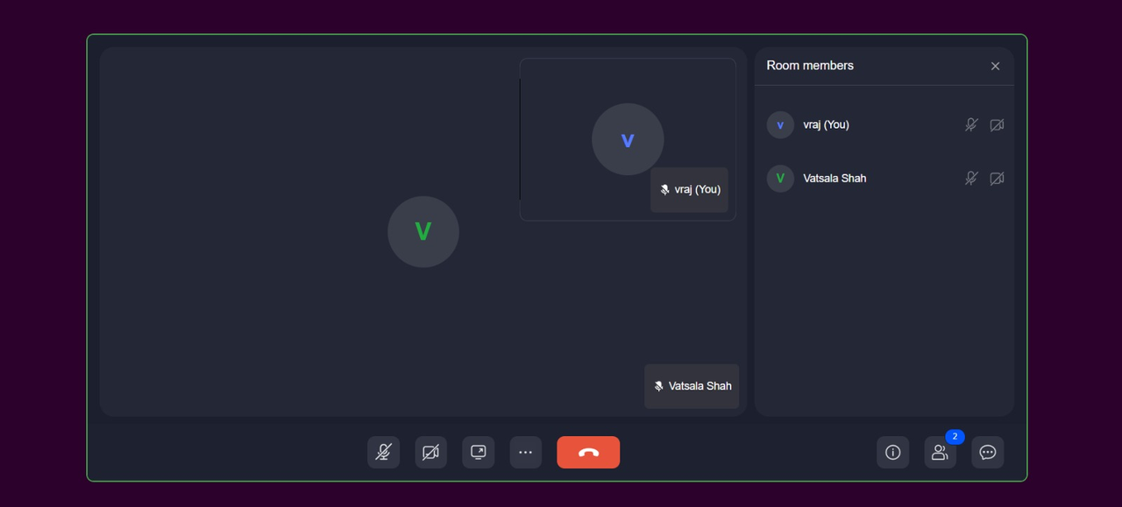

feature of Myntra Chat-App
Myntra Meet: Where fashion enthusiasts connect, discuss ideas, and stay ahead of the latest trends!

Slide 5
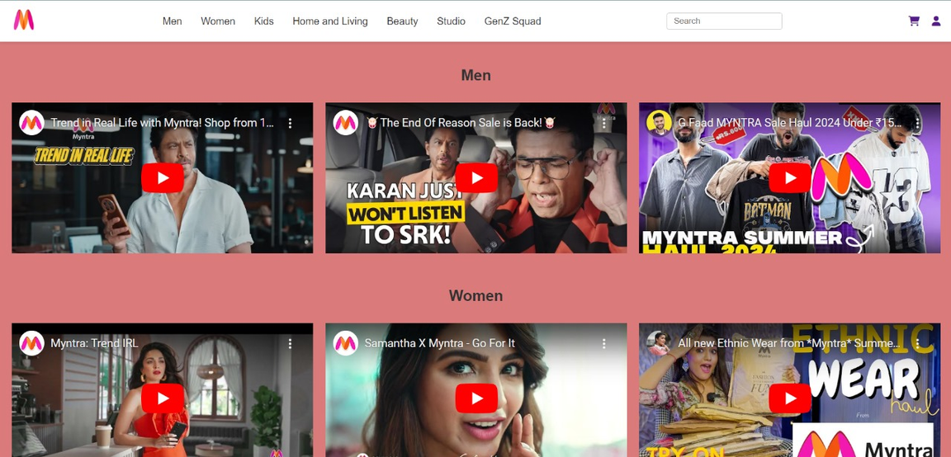
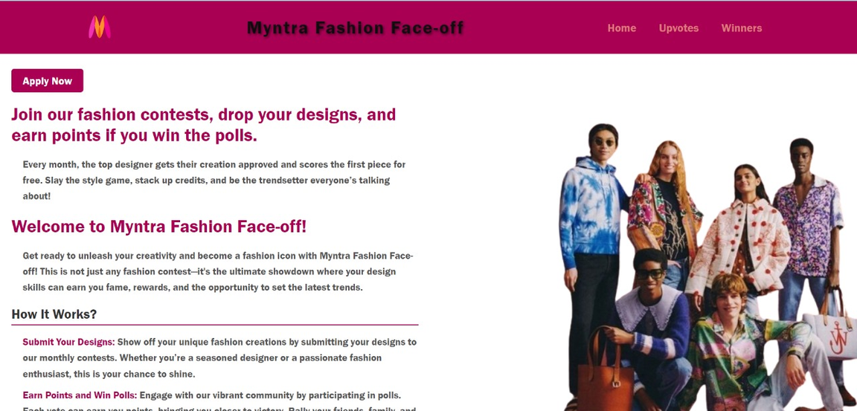

Myntra Chat-App feature: trendy videos are available
Myntra Fashion Face-Off: Enter contests and submit your designs via the apply link!

Slide 6
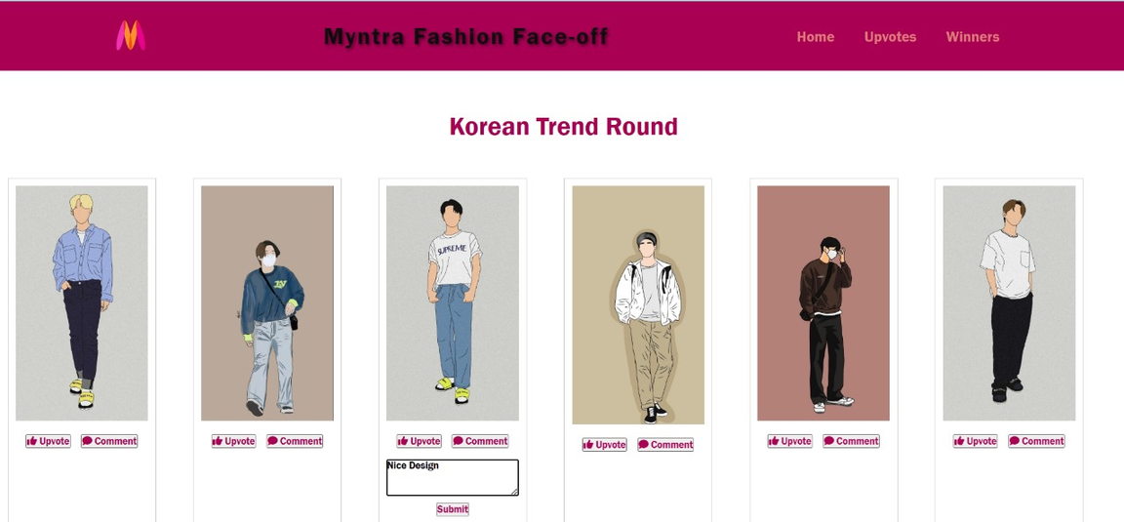
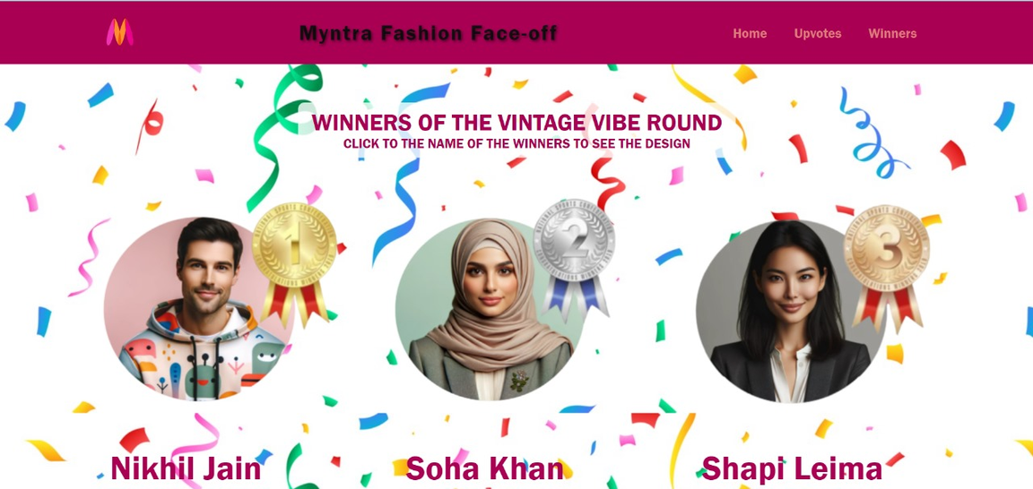
Comment, upvote your favorite designs, and the most upvoted wins!
Myntra Fashion Face-Off: Winners are decided by max upvotes and receive the first piece of their designs!
Users can visit the
winners’ designs by
clicking on their names

